Slide 1
Chongqing University of Technology
ATAI
Advanced Technique of Artificial Intelligence
Chongqing Unive
Powering Comparative Classification with Sentiment Analysis via Domain
Adaptive Knowledge Transfer
（EMNLP-2021)
Reported by Jia Wang
https://github.com/zyli93/SAECON
Notes:
通过领域自适应知识转移支持情感分析的比较分类

Slide 2
Chongqing University of Technology
ATAI
Advanced Technique of Artificial Intelligence
Chongqing University of Technology
1. Introduction
2. Approach
3. Experiments
4. Conclusion

Slide 3
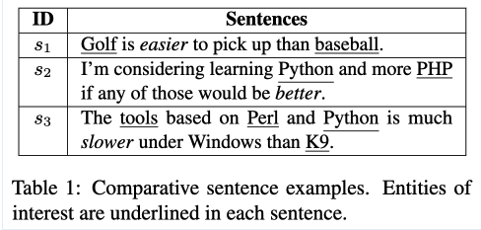
Introduction
Notes:
本文研究比较偏好分类 (comparative preference classiﬁcation (CPC)) 的任务。根据句子中的两个实体，我们的目标是区分第一个（或第二个）实体是否优于另一个实体，或者这两个实体之间根本没有比较。
将CPC视为一种句子分类，而忽略了语义和实体的上下文；ED-GAT堆叠的层数过多导致更大的计算工作量和降低训练稳定性，无法捕获全局或局部高质量语义上下文特征。

Slide 4
Introduction
• In this work, we propose a Sentiment Analysis Enhanced COmparative classification Network(SAECON), a CPC approach that considers not only syntactic but also semantic features of the entities. The semantic features here refer to the context of the entities from which a sentiment analysis model can infer the sentiments toward the entities.
• ABSA aims to detect the specific emotional inclination toward an aspect within a sentence.
Notes:
之前的工作一般都是将CPC视为一种句子分类，而忽略了语义和实体的上下文；ED-GAT堆叠的层数过多导致更大的计算工作量和降低训练稳定性，无法捕获全局或局部高质量语义上下文特征。在这项工作中，我们提出了一种情感分析增强的比较分类网络（SAECON），这是一种CPC方法，它不仅考虑了实体的句法特征，而且还考虑了实体的语义特征。这里的语义特征指的是实体的上下文，ABSA旨在检测句子中某个方面的特定情绪变化，情感分析模型可以从中推断对实体的情感，集成一个辅助的基于方面的情感分析（ABSA）模块，用于学习对比较分类非常有益的各个实体的情感

Slide 5
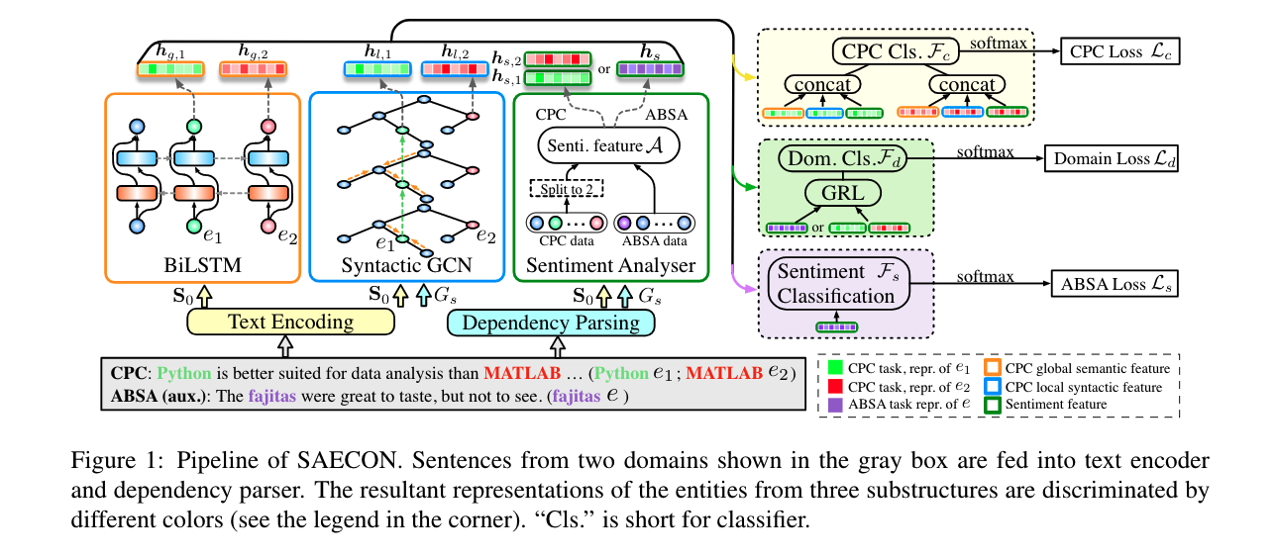
Approach
Notes:
为了减少领域转移，我们设计了一个领域自适应层来去除特定领域的特征，如主题，并保留领域不变的特征，如文本的情感，以便情感分析器能够将情感分析中的知识平滑地转移到比较分类中

Slide 6
Approach
Problem Statement
CPC
（e1、e2)
ABSA
Dc and Ds are similar but different in topics which produces a domain shift.

Slide 7
Approach
Text Feature Representations
（Stanford Parse
spaCy）
Notes:
一个句子通过文本编码器通过其单词表示进行编码，并通过依赖关系解析解析为依赖关系图; S的依赖关系图，用GS表示，通过将依赖关系解析器应用于Suchas Stanford Parse或者spaCy来获得。
Gs它由单词的顶点和依赖关系的有向边组成，可以很容易地检测到句子中遥远单词之间复杂的句法关系。

Slide 8
Approach
Contextual Features for CPC
Global Semantic Context

Slide 9
Approach
Contextual Features for CPC
Local Syntactic Context
Given a vertex v in Gs and its neighbors N(v), the vertex representation of v on the (j+ 1) th layer is given as
Notes:
GCN（Kipf和Welling，2017）相比，SGCN在有方向的依赖图上运行.

Slide 10
Approach
Contextual Features for CPC
Local Syntactic Context
Given a vertex v in Gs and its neighbors N(v), the vertex representation of v on the (j+ 1) th layer is given as
Notes:
GCN（Kipf和Welling，2017）相比，SGCN在有方向的依赖图上运行，并进行了三项主要调整：

Slide 11
Approach
Sentiment Analysis with Knowledge Transfer from ABSA
It reverses the gradients in the backward pass as
Notes:
具体地说，每个CPC实例在输入A之前被拆分为两个具有相同文本的ABSA示例（参见图1中的“拆分为2”）。一个作为查询的方面，另一个作为查询的方面。GRL（gradient reversal layer ）适应领域，它可以有效地消除移域带来的影响。这里，GRL的输入是x,α它是一个超参数，I是一个单位矩阵。在训练过程中，反向梯度使域loss最大化，通过反向传播使域标识被遗忘，从而减少了域移位，因此，输出对domian shift保持不变。但由于对ABSA预测的输出也进行了优化，因此保留了情绪分类方面的区别。

Slide 12
Approach
Sentiment Analysis with Knowledge Transfer from ABSA
Notes:
F具有非线性激活层的全连接神经网络
根据预测，SAECON分别计算LC、Ls和LD三个任务的交叉熵损失
其中λs和λd是损失的两个权重，λ是L2正则化调节的权重。我们表示λ={λs，λd，λ}。

Slide 13
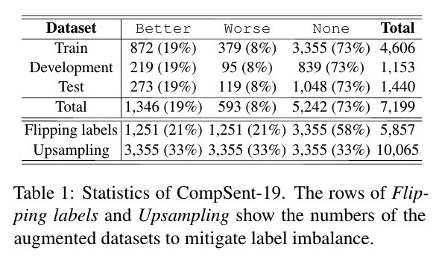
Experiments

Slide 14
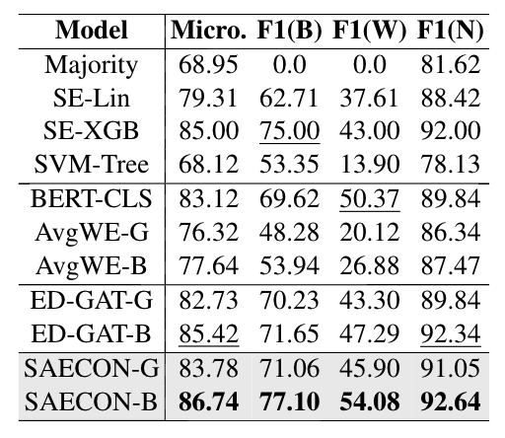
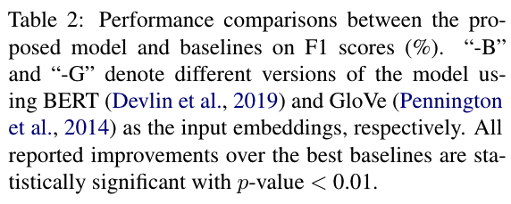
Experiments

Slide 15
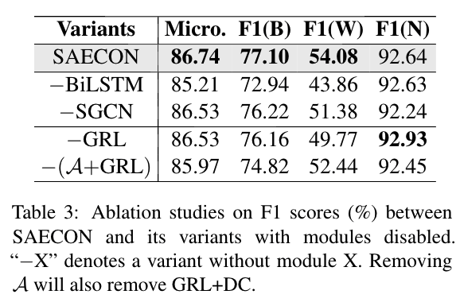
Experiments

Slide 16
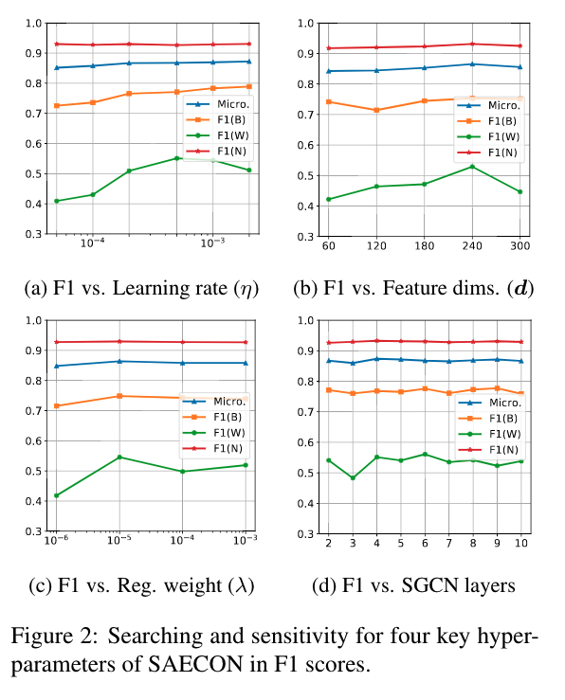
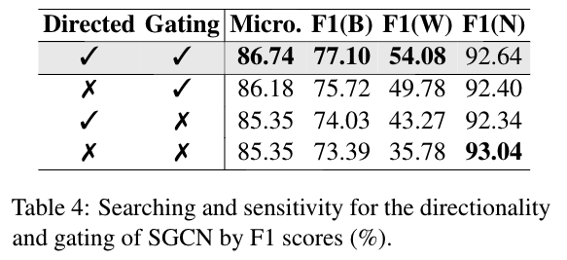
Experiments

Slide 17
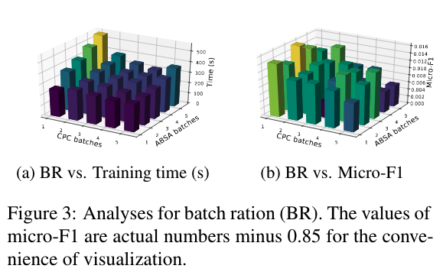
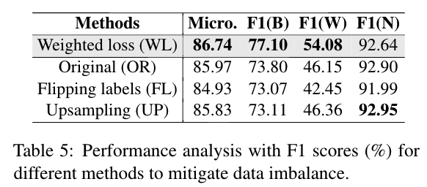
Experiments

Slide 18
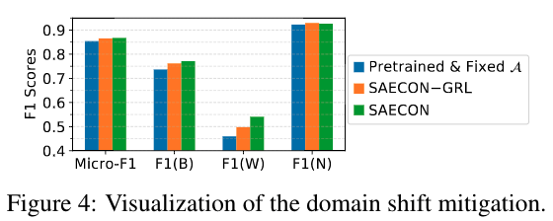
Experiments

Slide 19
Experiments

Slide 20
Conclusion
This paper proposes SAECON, a CPC model thatincorporates a sentiment analyzer to transfer knowledge from ABSA corpora. Specifically, SAECON utilizes a BiLSTM to learn global comparative features, a syntactic GCN to learn local syntactic information, and a domain adaptive auxiliary sentiment analyzer that jointly learns from ABSA corpora and CPC corpora for a smooth knowledge transfer. Analternative joint training scheme enables the efficient and effective information transfer. Qualitative and quantitative experiments verified the superiorperformance of SAECON. For future work, wewill focus on a deeper understanding of CPC data augmentation and an exploration of weighting loss methods for data imbalance.

Slide 21
Thanks

